Slide 1

HEALTHCARE ANALYTICS FOR DOCTOR VISITS
Presented by: Harsh Kumar
Department: Computer Science and Engineering – Data Science
Institution: MLR Institute of Technology

Slide 2

PROBLEM STATEMENT
Healthcare utilization varies across individuals based on demographic characteristics, health conditions, and access to healthcare services.
Understanding these factors is essential for identifying patterns in doctor visits and exploring differences in healthcare utilization across population groups.
This project analyzes healthcare-related data to investigate the relationship between patient characteristics and doctor-visit frequency using data analytics and statistical techniques.

Slide 3
Project Description
The Healthcare Analytics for Doctor Visits project focuses on exploring patterns in doctor-visit frequency using a structured healthcare dataset.
The analysis examines demographic variables such as age, gender, and income, along with health-related factors, illness levels, reduced activity, chronic conditions, and healthcare coverage.
The project follows a structured analytics workflow:
- Data loading and initial inspection
- Data quality assessment and preprocessing
- Exploratory Data Analysis (EDA)
- Univariate, bivariate, and multivariate analysis
- Statistical analysis and correlation assessment
- Data visualization and interpretation of findings
The objective is to transform raw healthcare data into meaningful insights that support a better understanding of healthcare utilization patterns.

Slide 4

WHO ARE THE END USERS?
- Healthcare Administrators: To understand healthcare utilization patterns across population groups.
- Healthcare Researchers: To explore relationships between health conditions and doctor visits.
- Public Health Analysts: To examine differences in healthcare utilization and access.
- Healthcare Policy Planners: To support data-informed discussions about healthcare services.
- Data Analysts and Students: To study healthcare data using exploratory and statistical techniques.
Potential Application:Supporting evidence-based healthcare analysis and further research.
*Note: These are potential users of the analysis, not confirmed users of the project.*

Slide 5

Technology Used
  Language: Python
  latform: Google Colab
  Libraries: Pandas, NumPy, SciPy
  Visualization: Matplotlib, Seaborn
  Techniques: Data Cleaning, EDA, Statistical Analysis, Correlation Analysis, Data Aggregation
  Dataset: Healthcare Analytics for Doctor Visits (CSV)

Slide 6
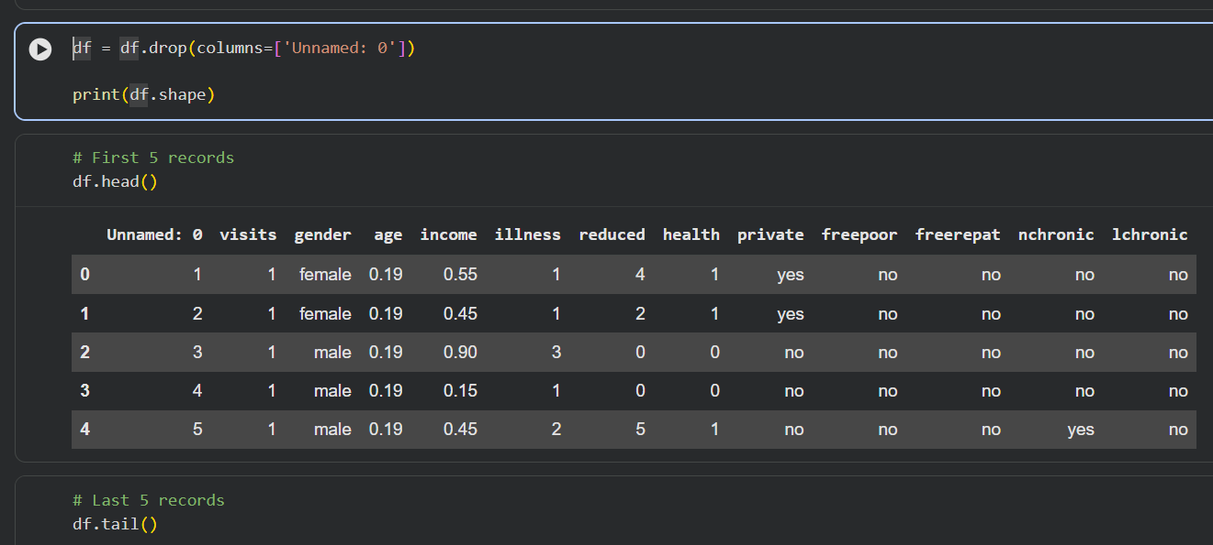
RESULTS
Demo Link

Slide 7
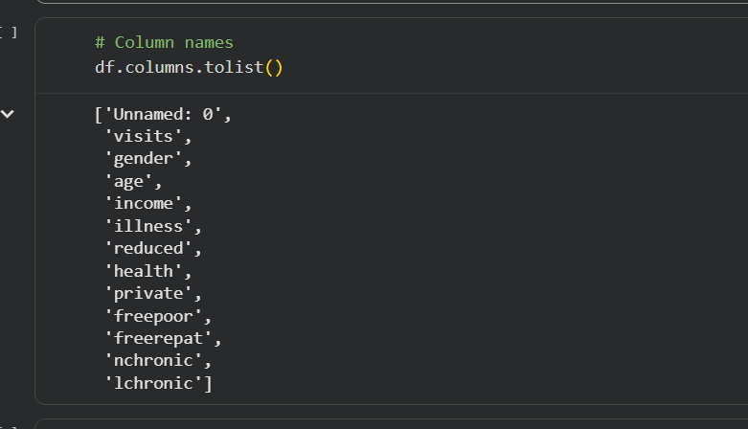
.
.

Slide 8
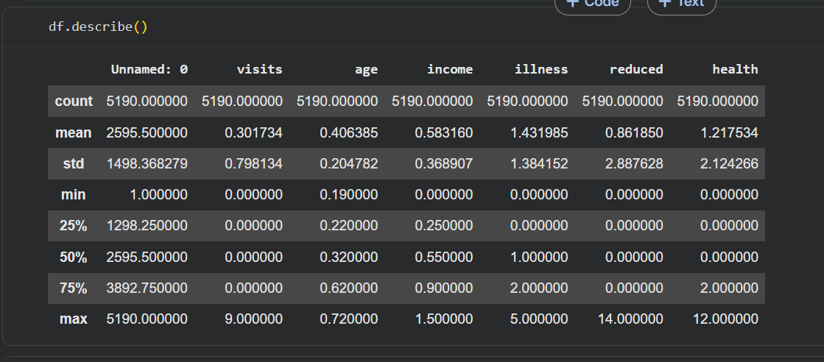
.
.

Slide 9
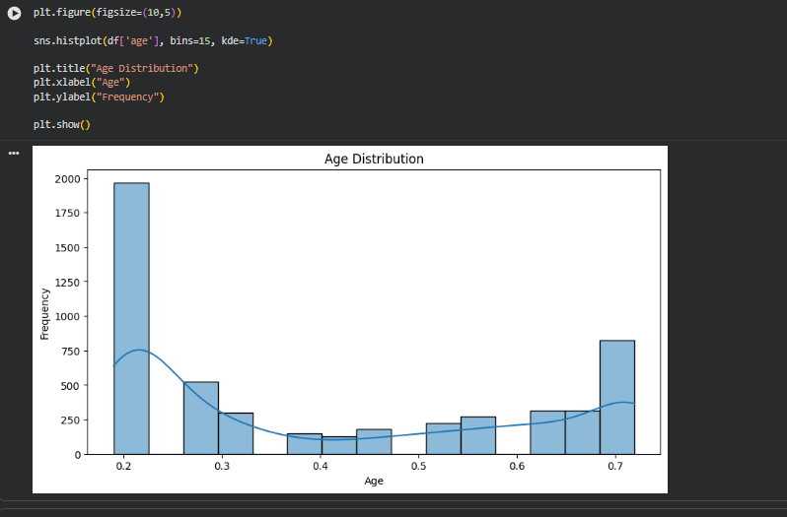
.
.

Slide 10
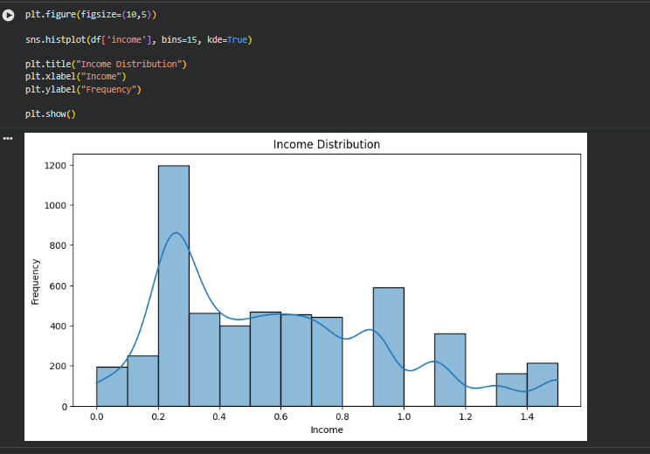
.
.

Slide 11
GITHUB LINK: https://github.com/harshkumar688/MAJOR-PROJECT-VOIS.git
.
.

Slide 12
Thank youuu
.
.

